Slide 1
KAU AI Drone Racing using Airsim
ForFun
2016121150 항공우주및기계공학부 윤준영
2018121084 항공우주및기계공학부 박종윤
2022130038 자율주행시스템공학과 최민서

Slide 2
ForFun
CONTEXT
01
04
02
03
Process
Keypoints
Video
Challenges

Slide 3
01
ForFun
Keypoints
Keypoints
Finish without missing gates​
2. As fast as possible​
​
3. Apply AI modles​

Slide 4

02
ForFun
Challenges
Challenges
​
1. Stop and go, swing​
2. Overshooting​
3. POV problem​
4. Yaw angle

Slide 5
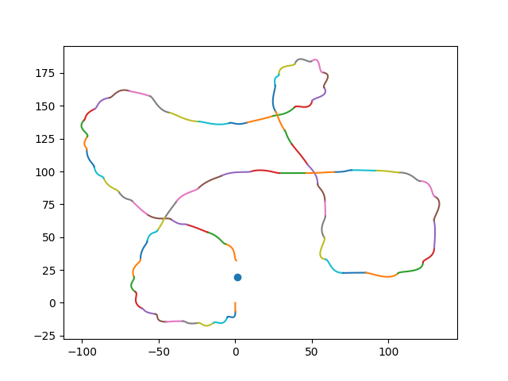
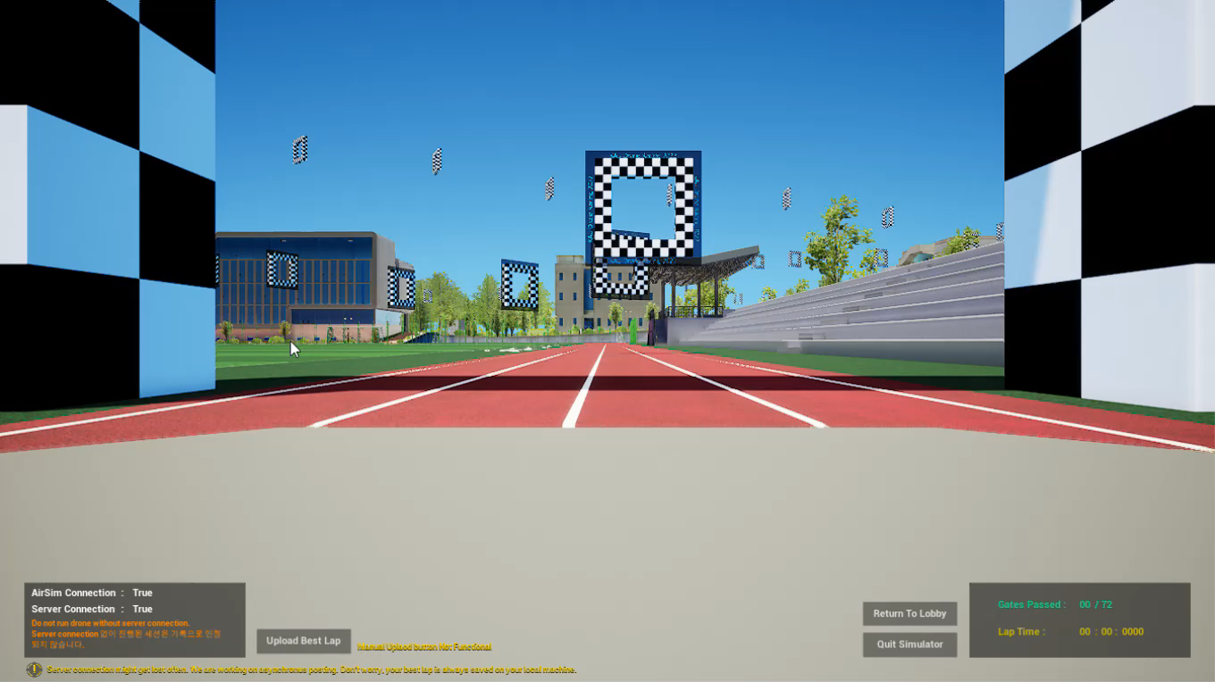
02
ForFun
Challenges
Challenges
1. Stop and go, swing
PD-control
2. Overshooting
Ferguson Curve
3. POV problem
4. Yaw angle

Slide 6
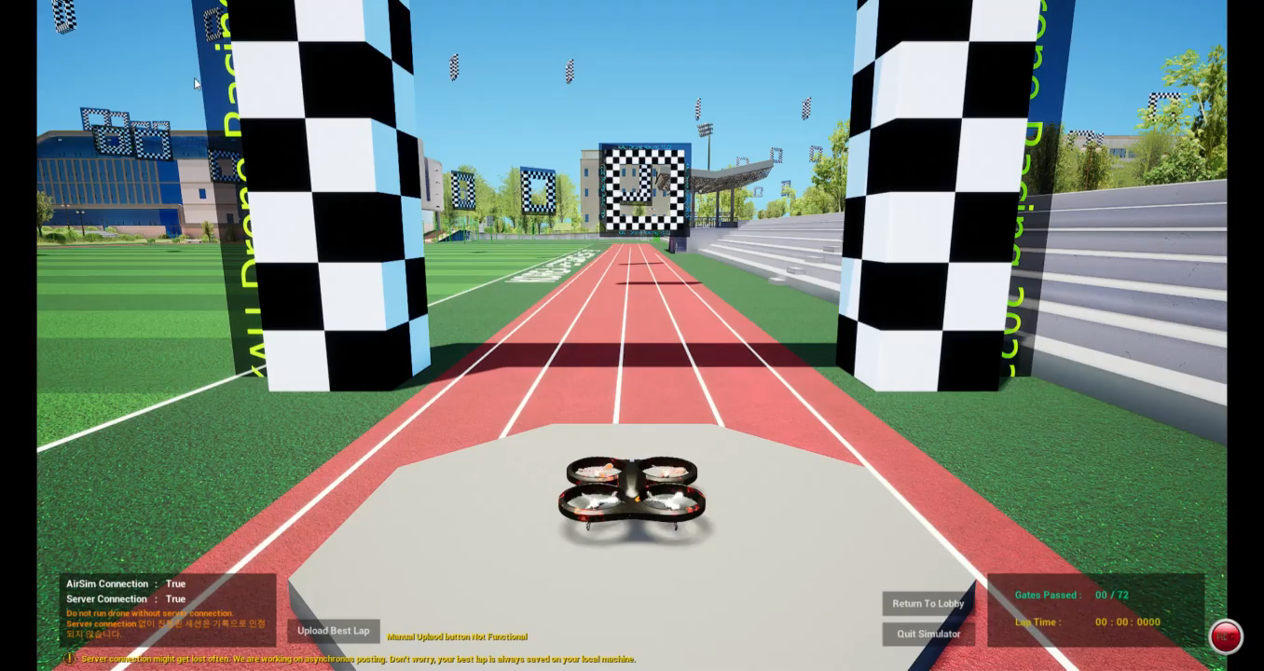
02
ForFun
Challenges
Challenges
1. Stop and go, swing
Velocity control
2. Overshooting
Variable speed(MLP)
3. POV problem
4. Yaw angle

Slide 7
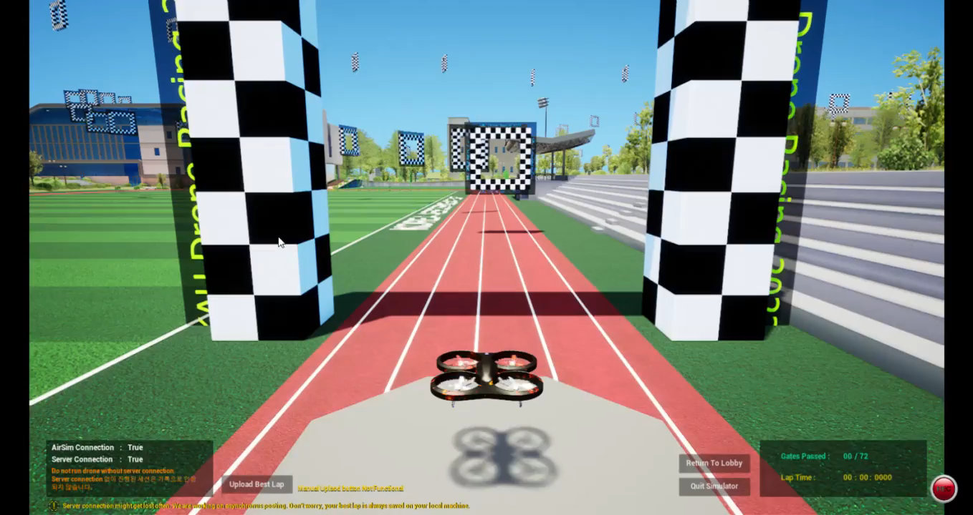
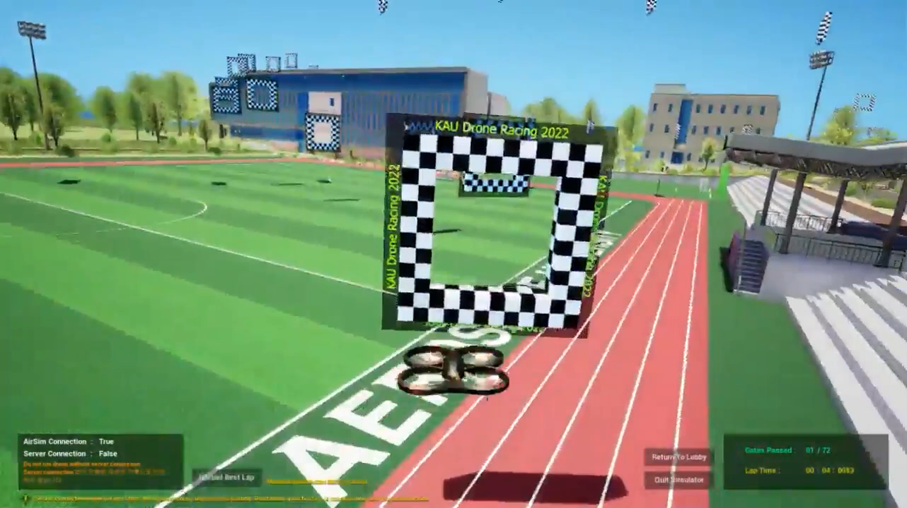
02
ForFun
Challenges
Challenges
1. Stop and go, swing
Velocity control
2. Overshooting
Variable speed(MLP)
3. POV problem
Join → Polling
4. Yaw angle

Slide 8
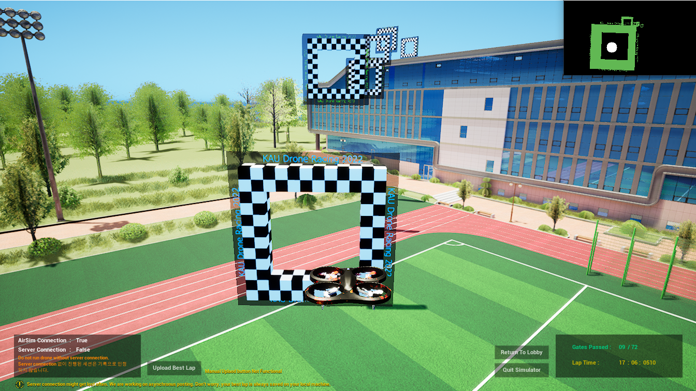
02
ForFun
Challenges
Challenges
1. Stop and go, swing
Velocity control
2. Overshooting
Variable speed(MLP)
3. POV problem
Join → Polling
4. Yaw angle
Yaw mode

Slide 9
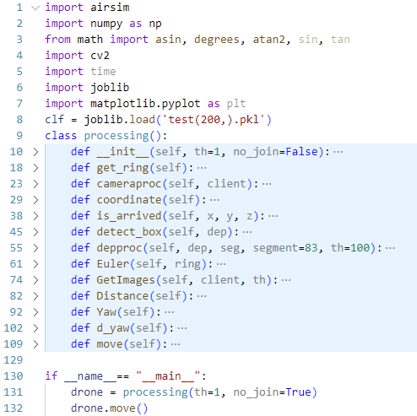
03
ForFun
Process
Process
init: 함수 초기화
get_ring: ring 정보 추출
cameraproc: 카메라 프로세싱 파이프라인
GetImages: Depth와 Segmentation 이미지 추출
detect_box: 이미지에서 사각형 중점 계산
depproc: Depth와 Segmentation이미지를 통해 ring 검출
is_arrived: ring에 도달했는지 여부 계산
Distance: 현재 위치와 목표점 사이의 거리 계산
Yaw: ring 정보에서 yaw값 계산
Euler: ring의 yaw, roll, pitch 연산

Slide 10
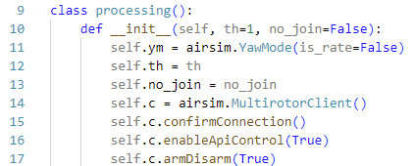
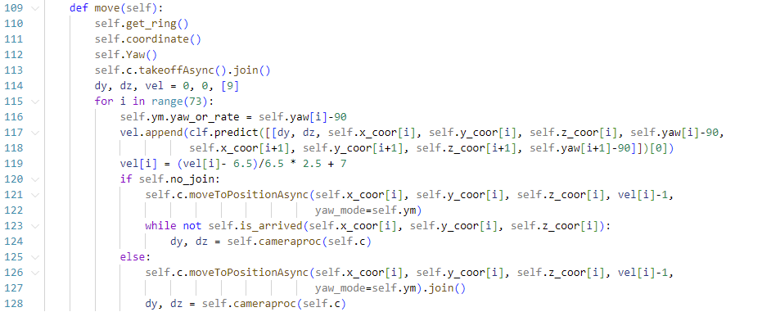
03
ForFun
Process
Process

Slide 11
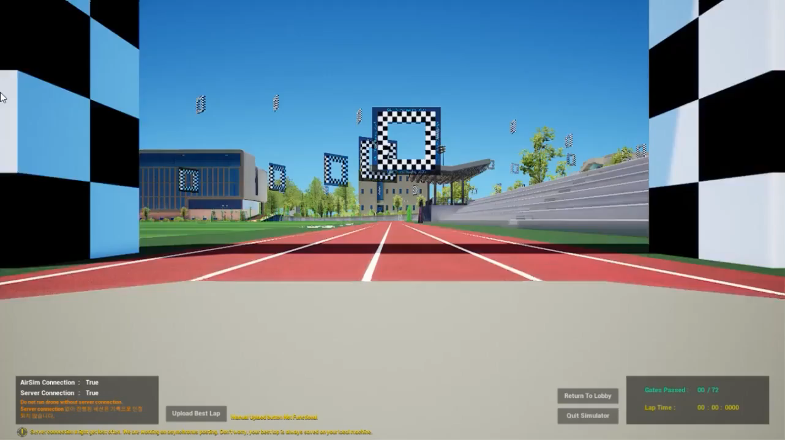
04
ForFun
Video (x1.5)
최종 영상 넣기

Slide 12
ForFun
Thank you

